Slide 1

Building a future
Huseyn Quliyev, Leyla Nazarali, Ali Aliyev

Slide 2
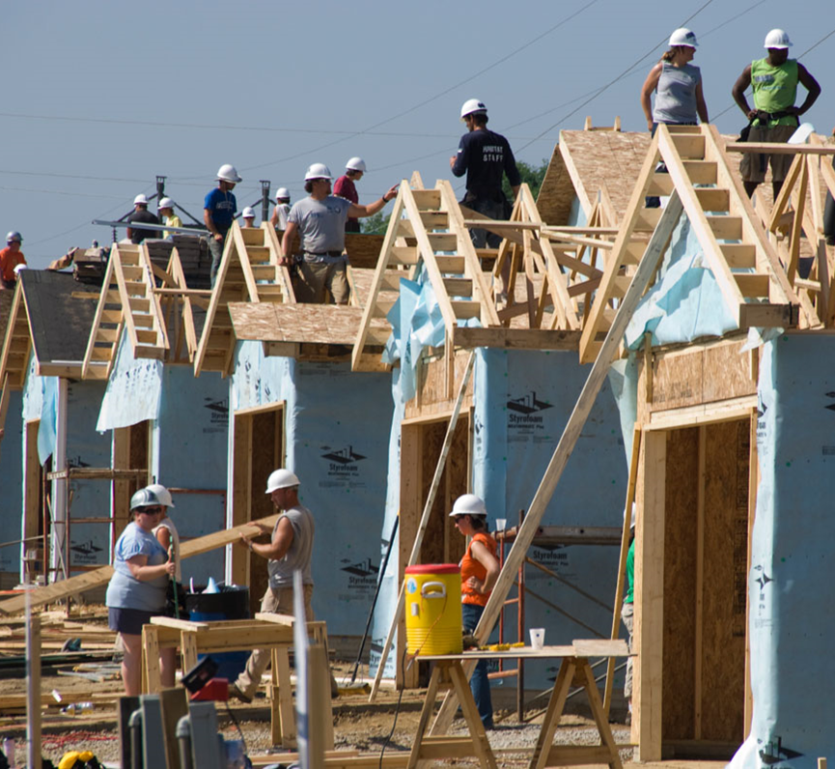
Information about organization
Nonprofit housing ministry whose mission is to eliminate poverty and homelessness...

Slide 3

Notes:
https://youtu.be/TuubFY6OAcM

Slide 4

Case Introduction
In 2009, J. Ronald Terwilliger, a former CEO of housing developer Trammell Crow Residential Co., made a
$100 million
commitment to Habitat. "It’s one of the largest gifts in recent years to a group devoted to social services.”

Slide 5
1.1. What role do you think goals would play in planning for the wise use of this gift?
Improved performance
Improved expectations
increased motivation
progress can be accessed

Slide 6
1.2. List some goals you think might be important. (Make sure these goals have the characteristics of well-written goals.)
Acquire an inventory of land
Construct, renovate and repair
Develop community partnerships
Broaden volunteer engagement
Finance the development

Slide 7
2. What types of plans would be needed in wisely using this gift? (For instance, long-term or short-term, or both?) Explain why you think these plans would be important.
Long term:
Short term:
Capital expenditures
Quality fixing
Policies and procedures
Employee training courses
Equipment servicing

Slide 8

3. What contingency factors might affect the planning Habitat executives have to do for the wise use of this gift? How might those contingency factors affect the planning?
Environmental uncertainty
Fraud
Time-frame

Slide 9
4. What planning challenges do you think Habitat executives face with getting the most use out of this gift? How should they cope with those challenges?
Challenge​ | Solution​
Disagreement among executives​ | Effective communication​
booming underprivileged citizens​ | To be more selective when choosing people​
Less land in urban areas​ | Efficient use of land e.g. vertical concept (flats)​

Slide 10
Thanks for attention!

